Slide 2
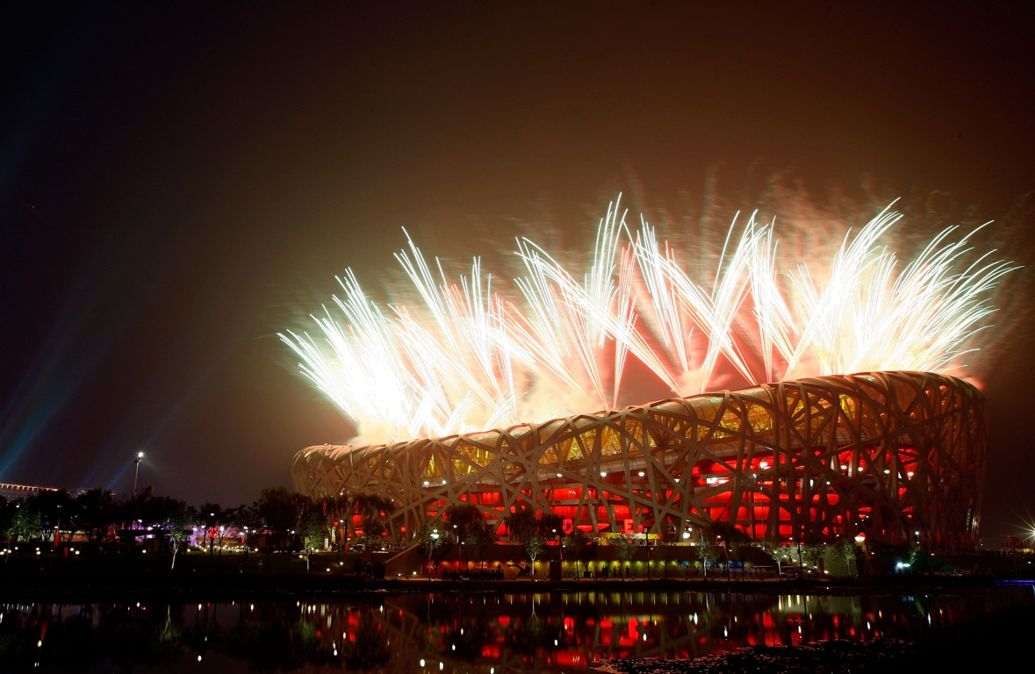
WE WOULD LIKE TO THANK YOU FOR HOSTING OUR GRACIOUS EVENT

Slide 3
THE ORIGIN OF
PHI means “GOLDEN RATIO” in Greek
By combining the word “Tone” Phiaton pursues untouchable sound quality with elegant timeless design

Slide 4
Significant growth in after market
WHY PHIATON?
Growth of high end market
Need of high quality and functionality

Slide 5
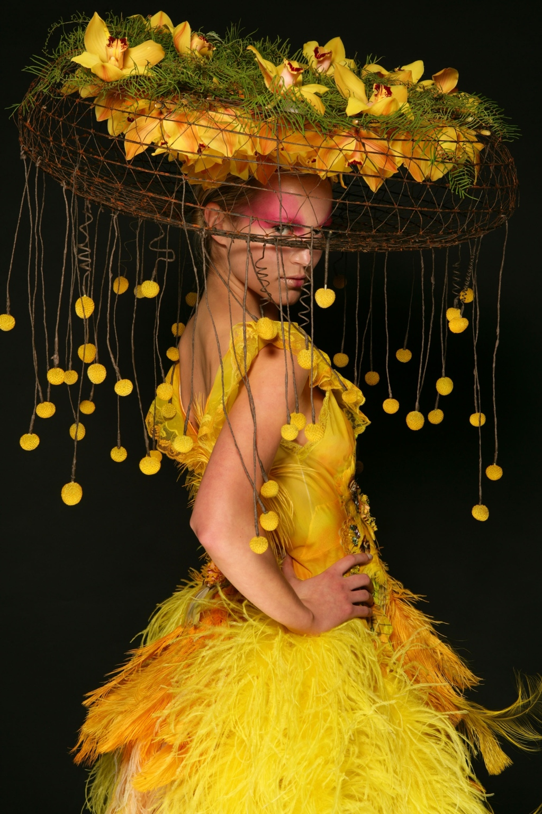
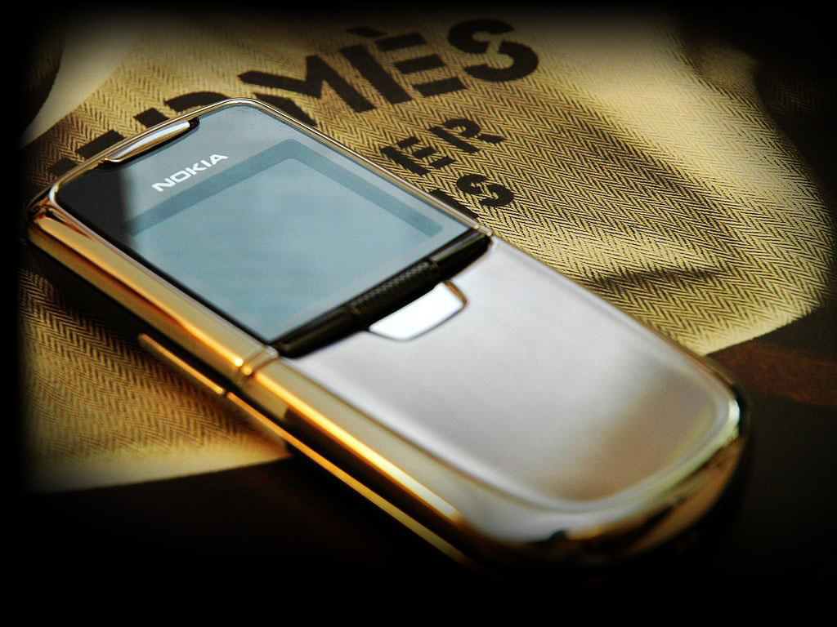
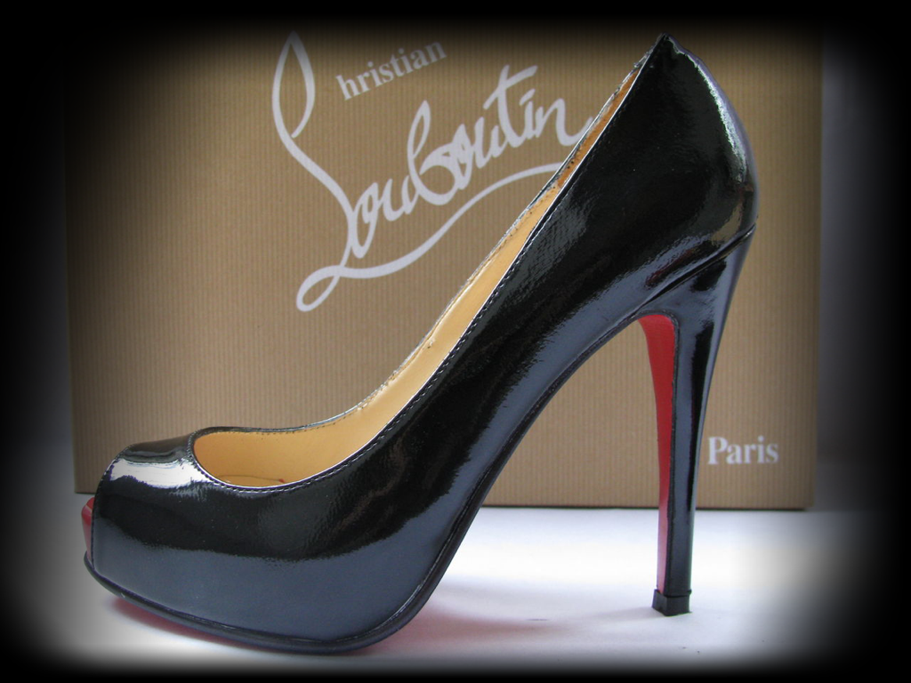
Phiaton’s primary design inspiration
FASHION

Slide 6
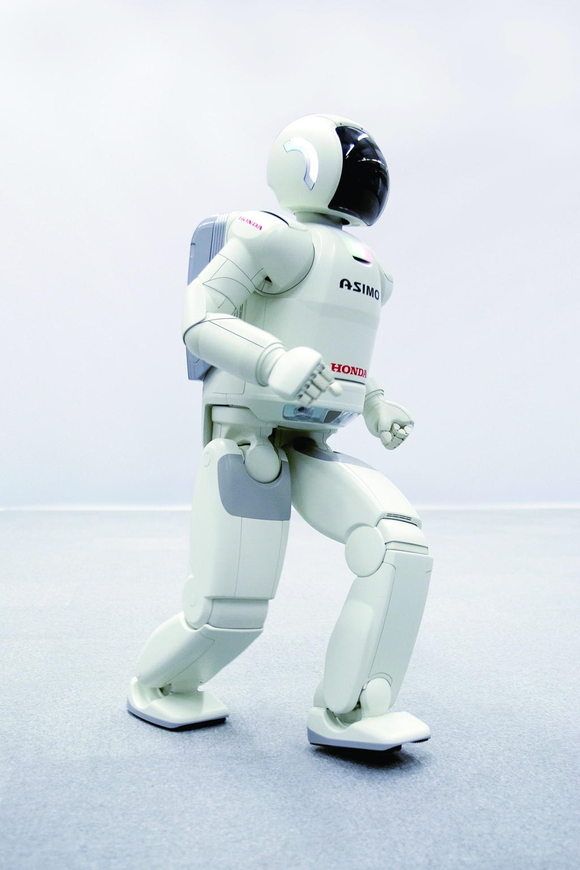
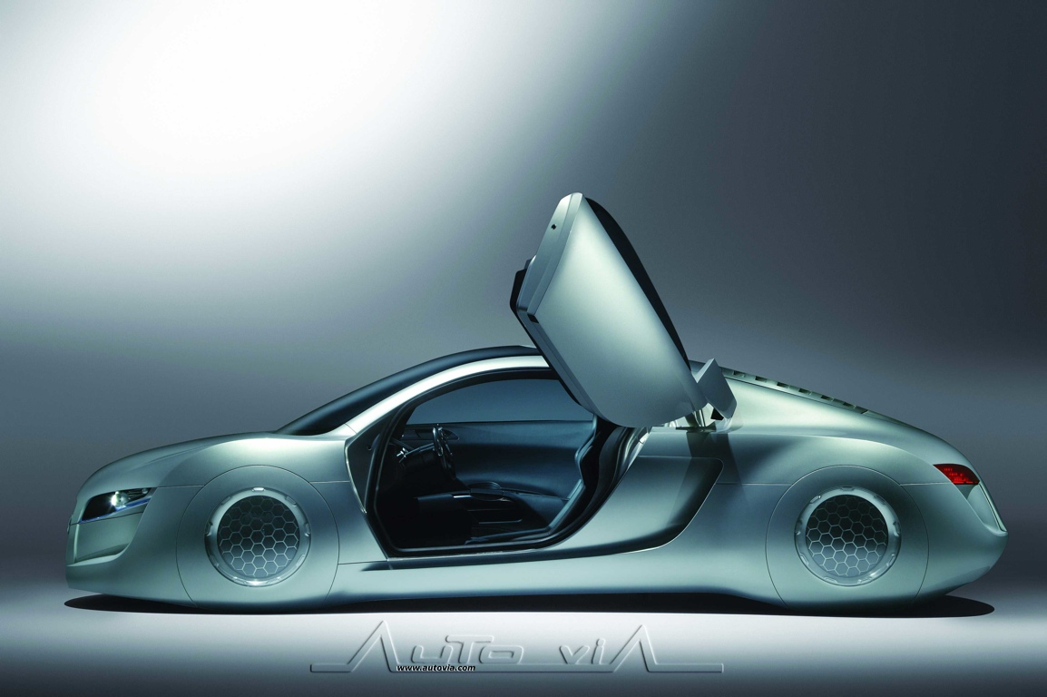
ADVANCED TECHNOLOGY

Slide 7
ERGONOMICS

Slide 8
ECO-FRIENDLY

Slide 11
PHIATON COLLECTION
MODERNA SERIES
PRIMAL SERIES

Slide 12
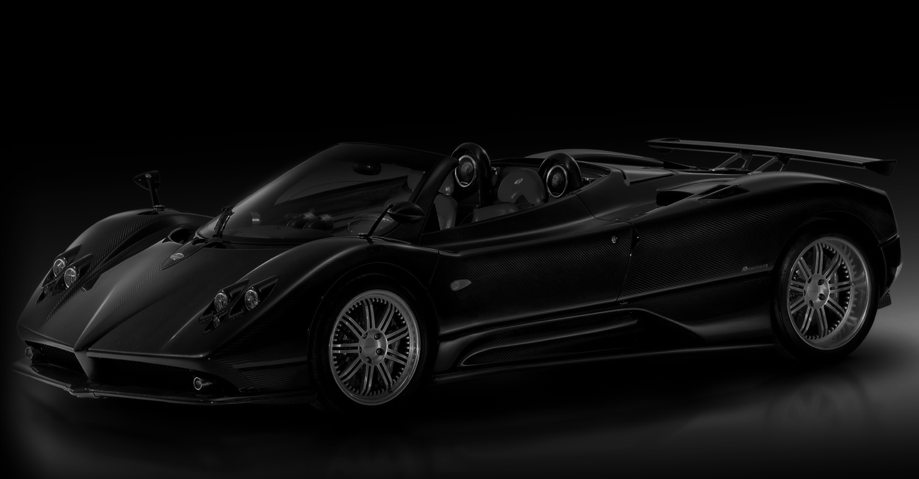
MODERNA SERIES
FIRST HEADPHONES IN THE WORLD
TO USE CARBON FIBER FOR HOUSING
STRIKING COLOR COMBINATION
PREVENTS SOUND LEAKAGE
LIGHT WEIGHT
PROVIDES SUPERIOR SOUND QUALITY

Slide 13
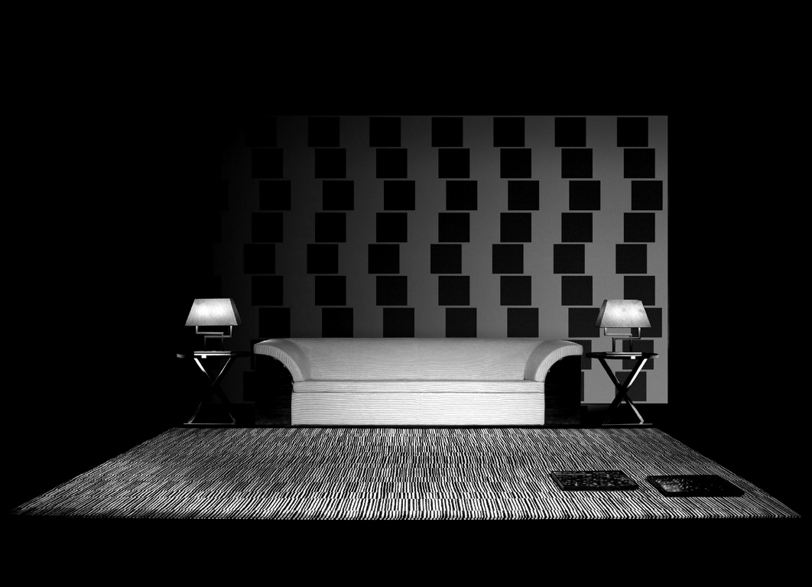
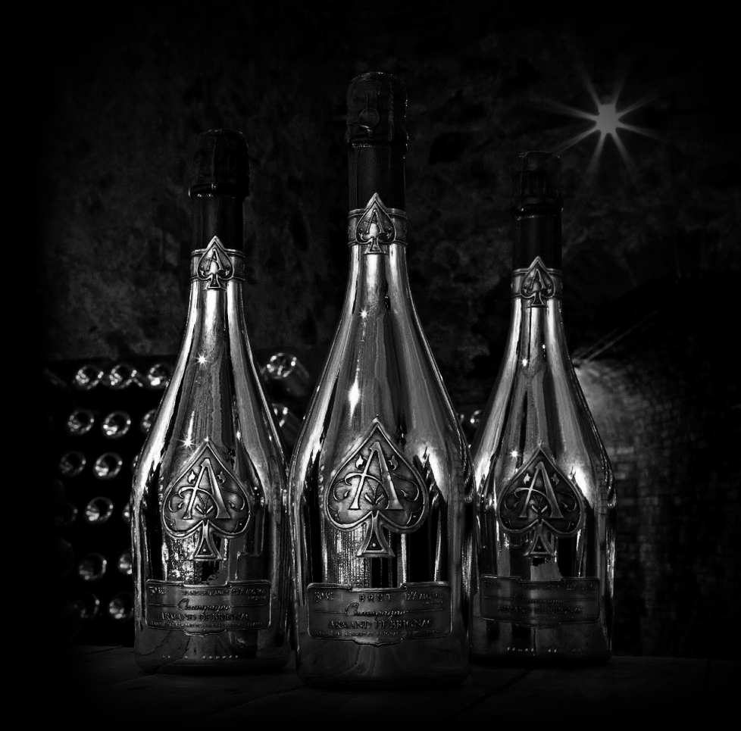
PRIMAL SERIES
UNCOMPROMISING QUALITY
HIGHEST CRAFTSMANSHIP
UNBELIEVABLE SOUND QUALITY

Slide 14
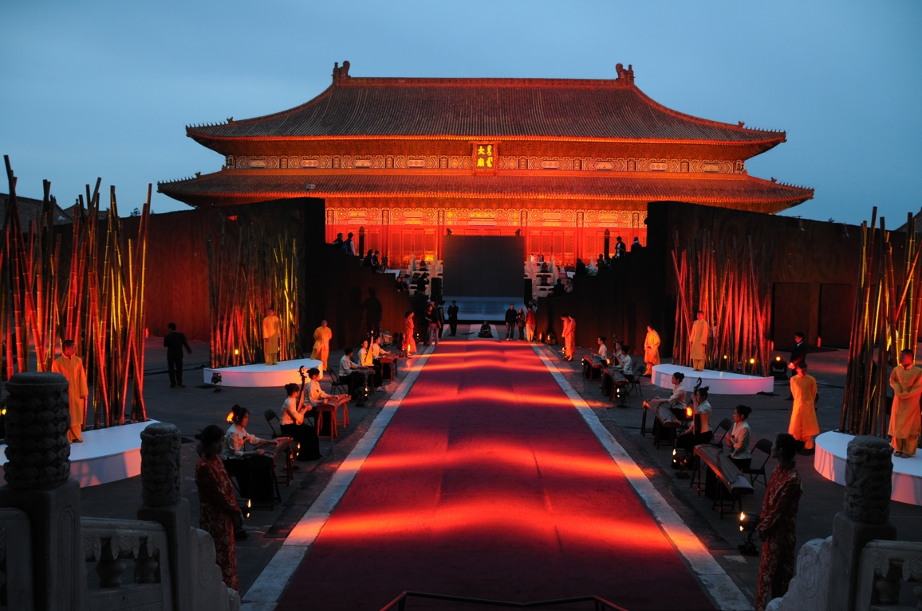
GERMANY
May. 2009
NORWAY
Jul. 2009
U.K.
May. 2010
AUGUST 2010
NOW AVAILABLE IN CHINA
U.S.A.
JAN, 2008
FRANCE
Sep. 2009
KOREA
Sep. 2008
JAPAN
Apr. 2009
COUNTRIES WHERE PHIATON IS AVAILABLE

Slide 15
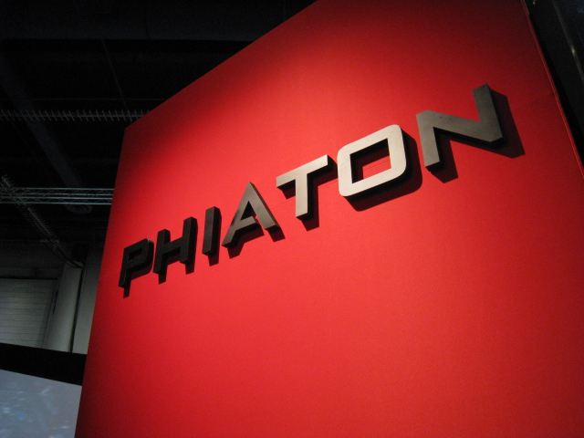
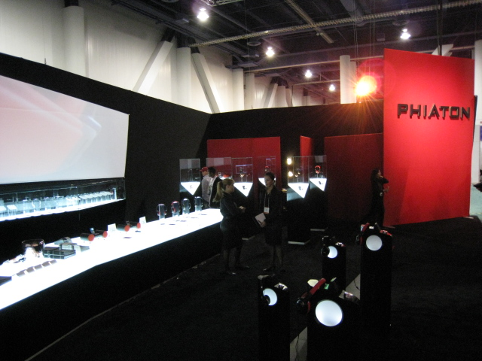
PREVIOUS EVENTS
CES 2008

Slide 16
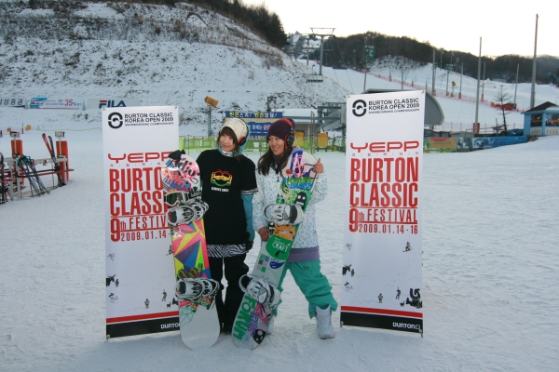
BURTON CLASSIC
SNOWBOARDING COMPETITION
KOREA, 2008

Slide 17
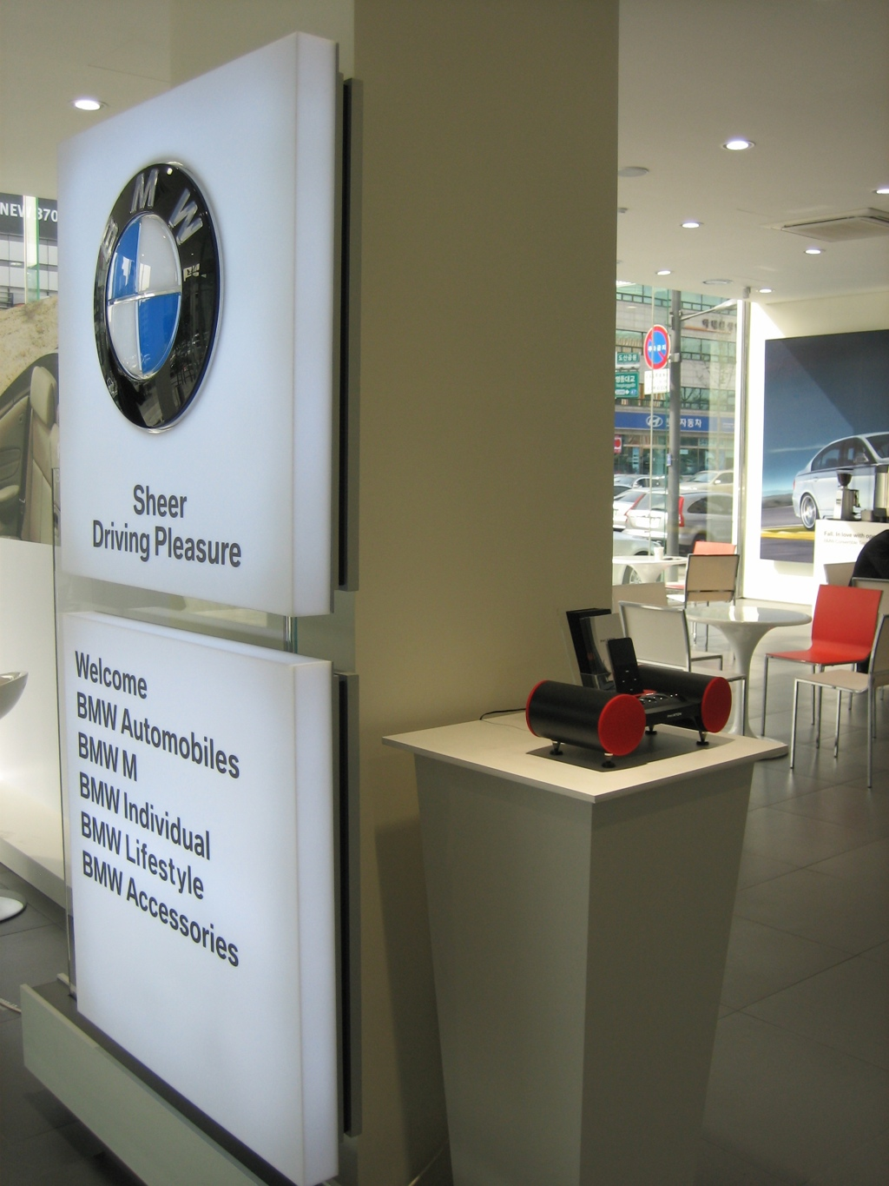
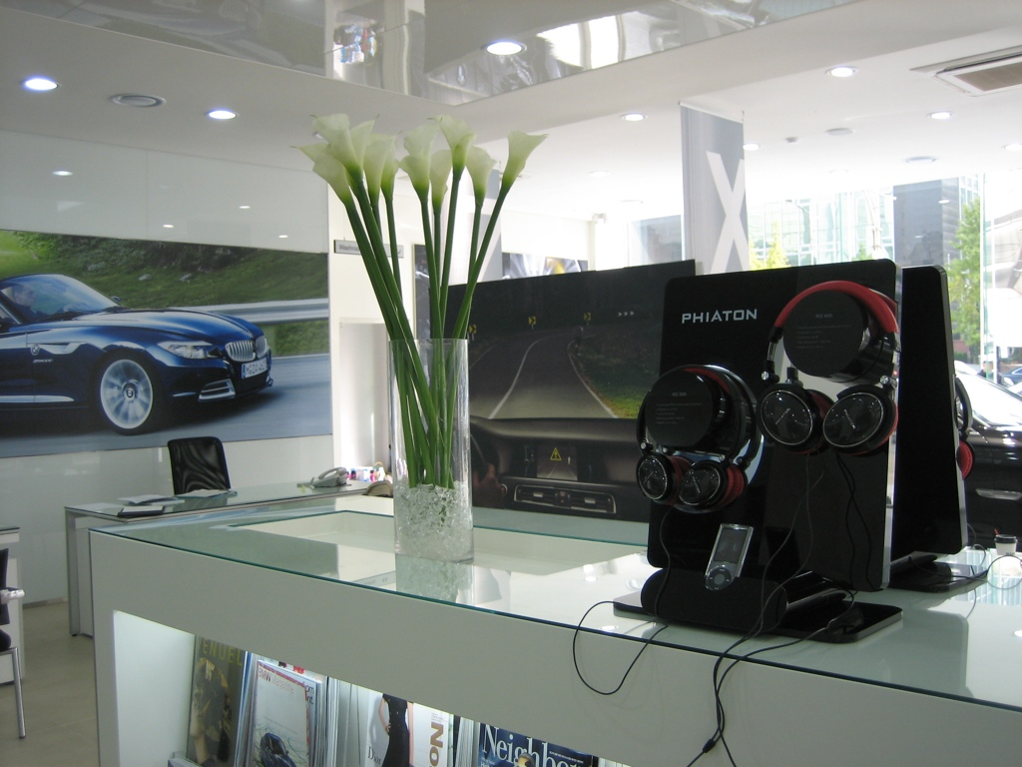
BMW Z4 LAUNCING EVENT
SEOUL, KOREA 2009

Slide 18
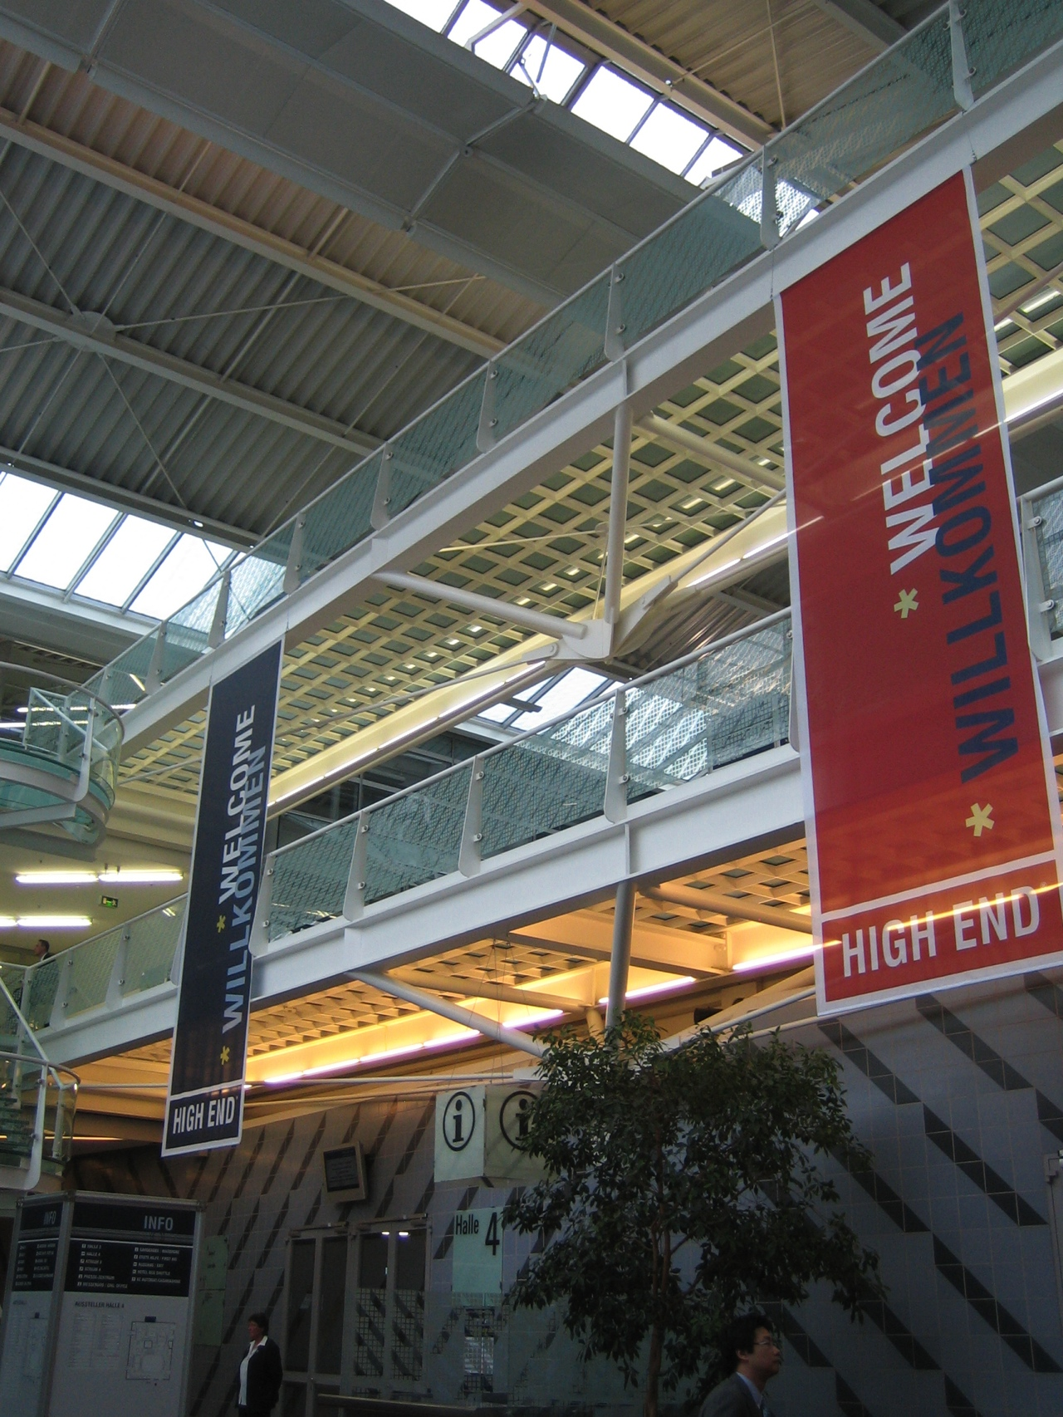
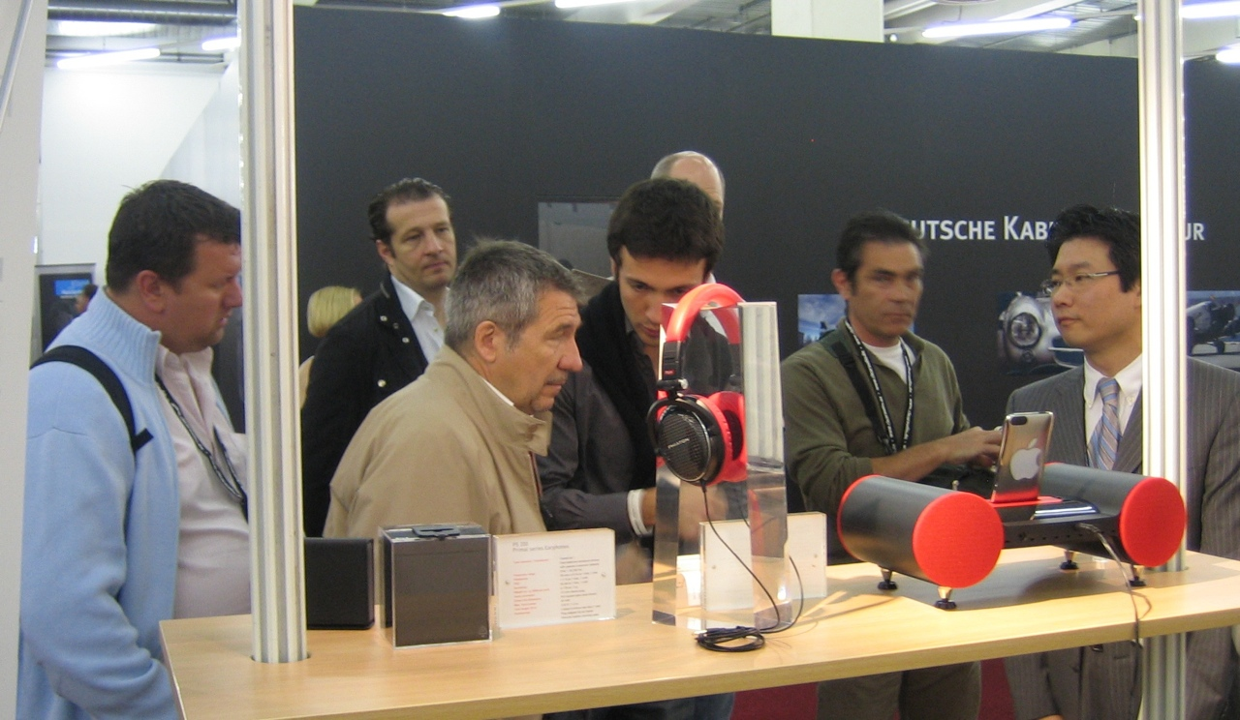
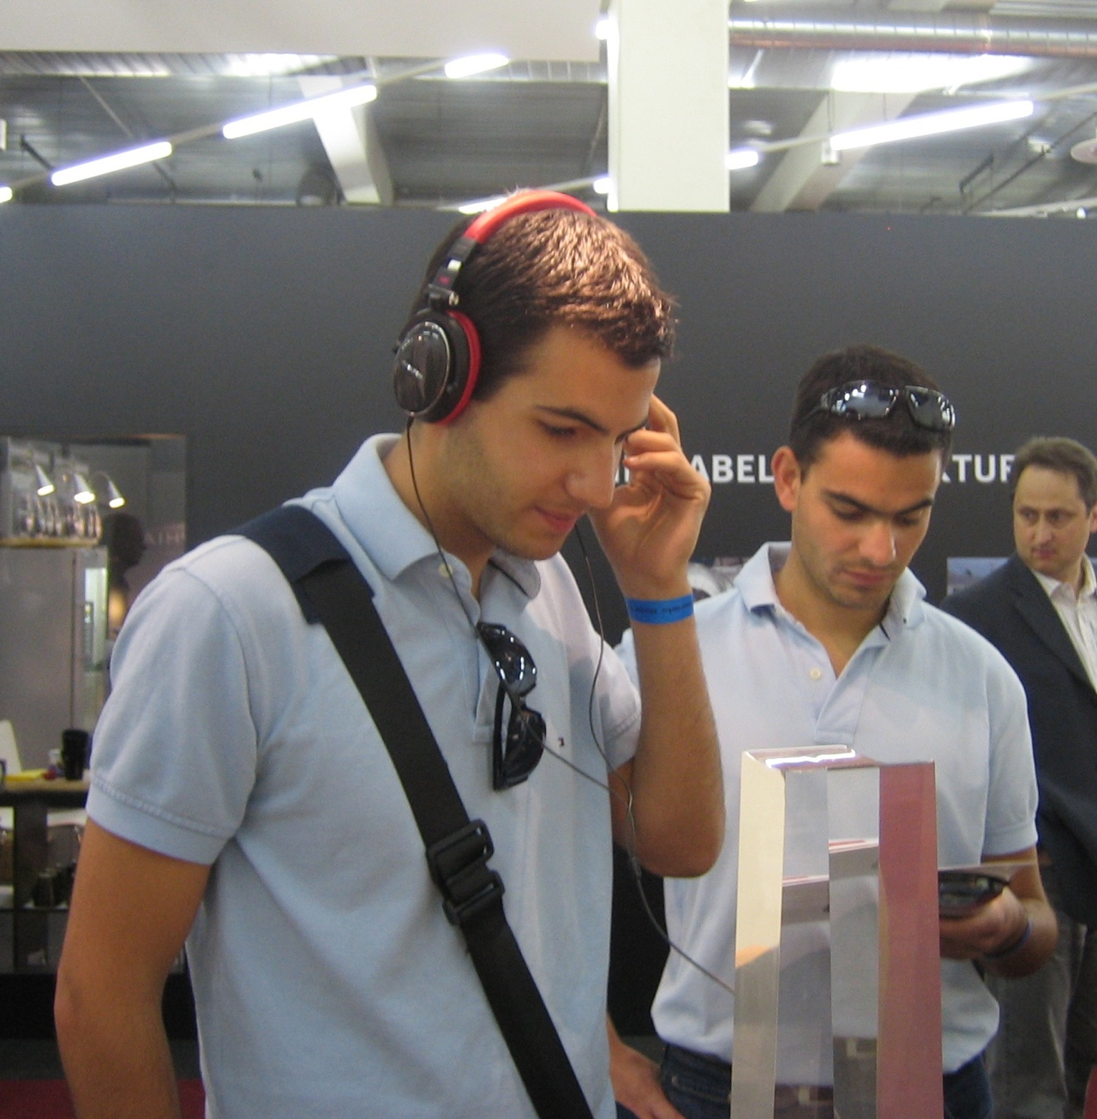
GERMANY HIGH END SHOW
MUNICH, 2009

Slide 19
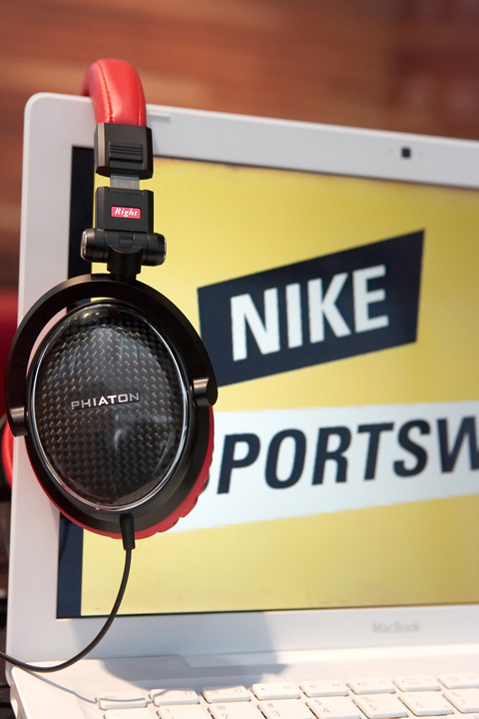
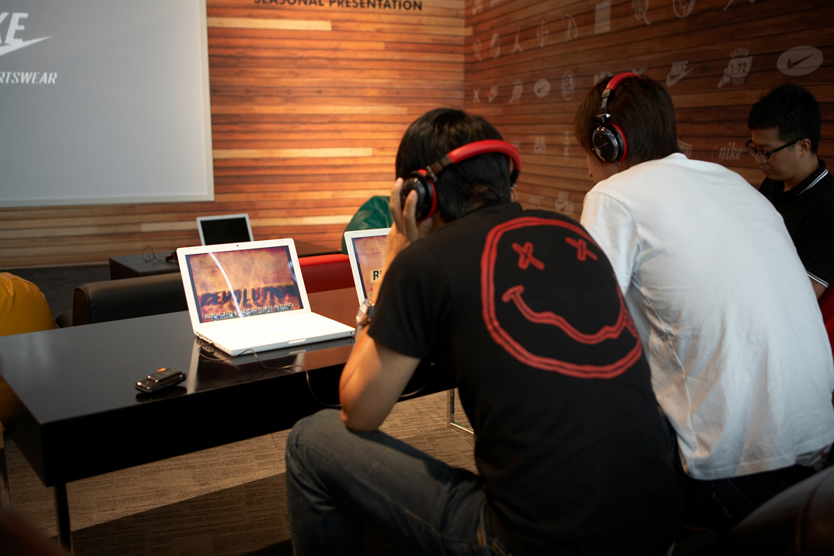
NIKE SPORTSWEAR
FALL LINE LAUNCHING EVENT 2009

Slide 20
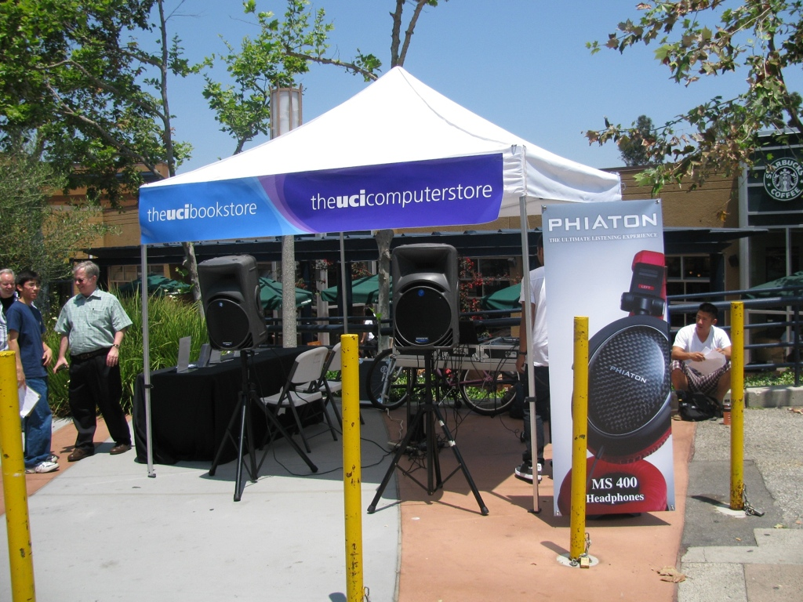
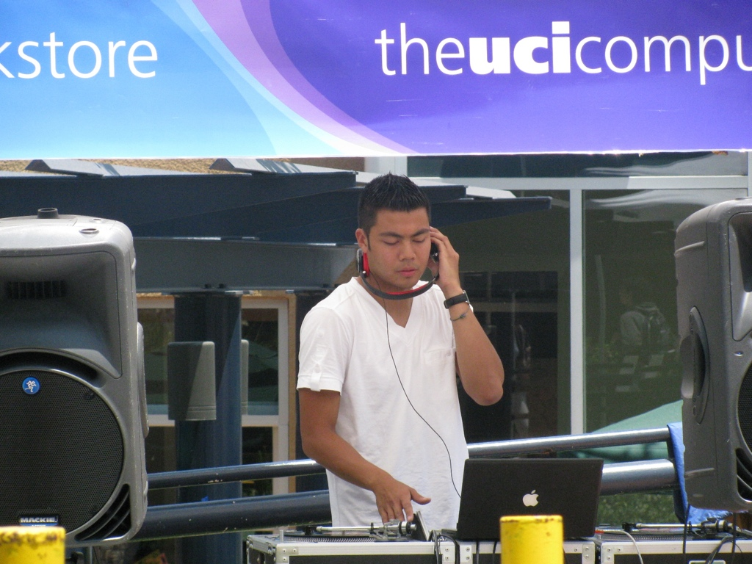
UNIVERSITY OF CALIFORNIA IRVINE
PHIATON DAY, 2009

Slide 21
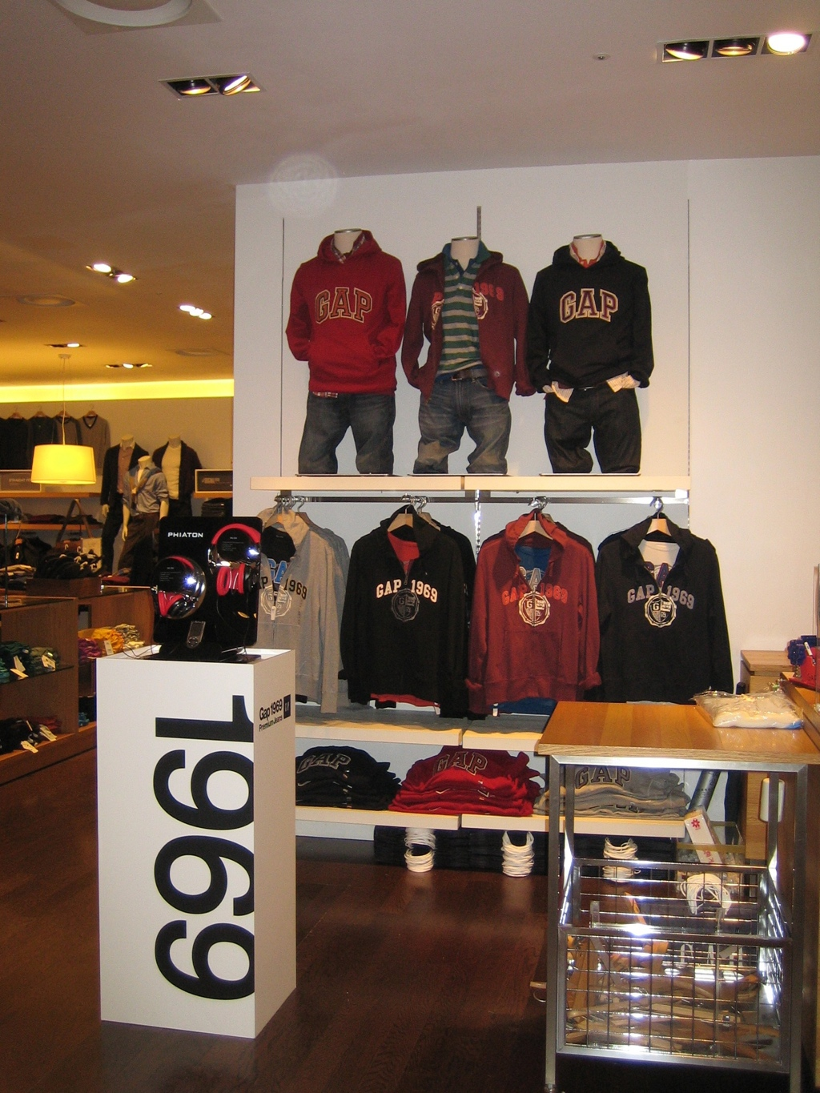
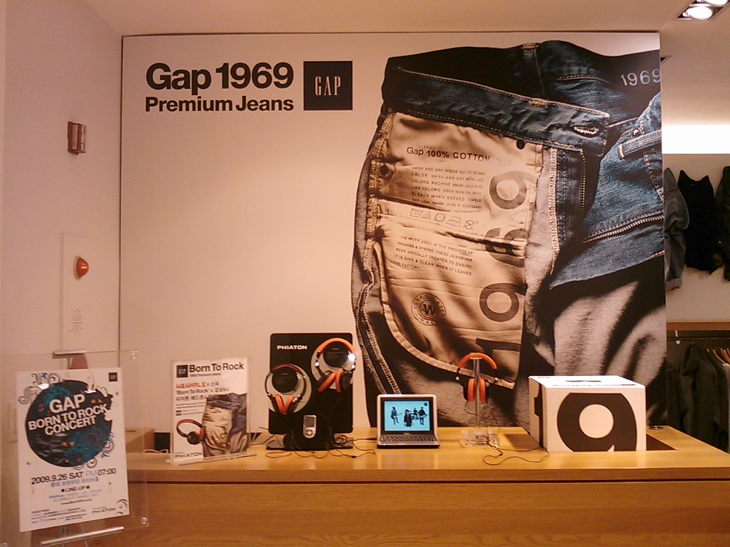
GAP 1969 PREMIUM JEAN LAUNCHING EVENT SEOUL, KOREA 2009

Slide 22
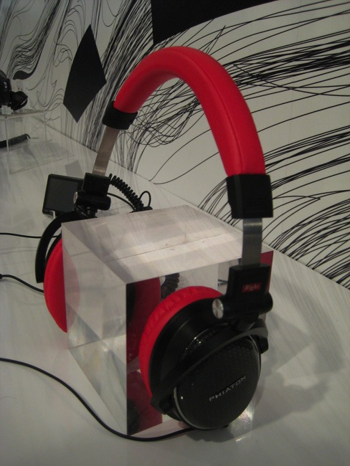
WIRED STORE NYC, 2009

Slide 23
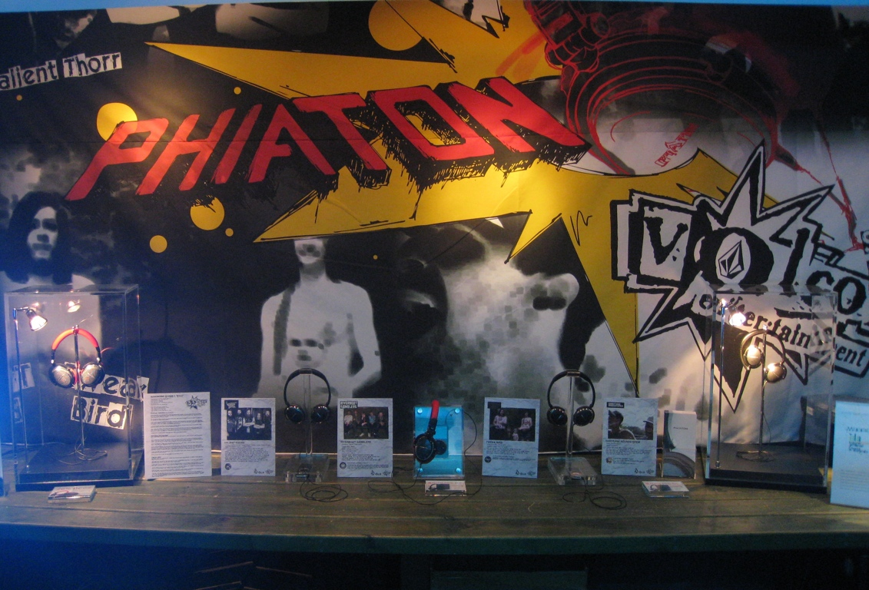
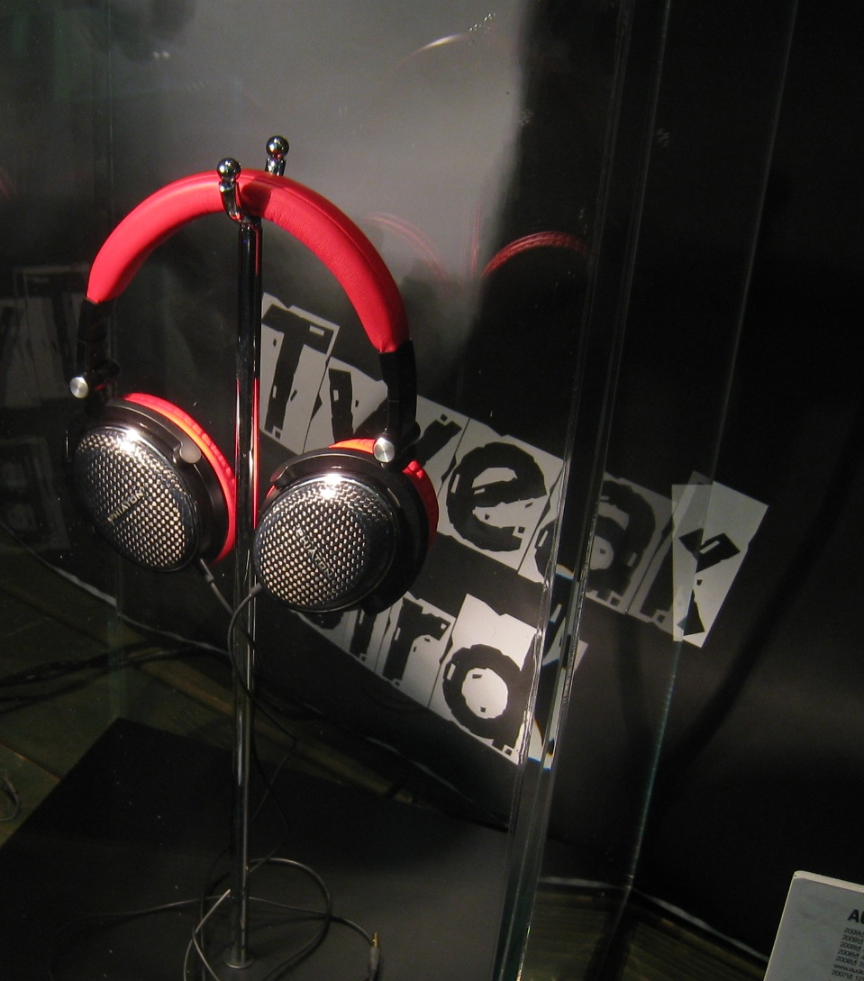
VOLCOM ARTIST CD RELEASE PARTY
SEOUL, KOREA 2009

Slide 24
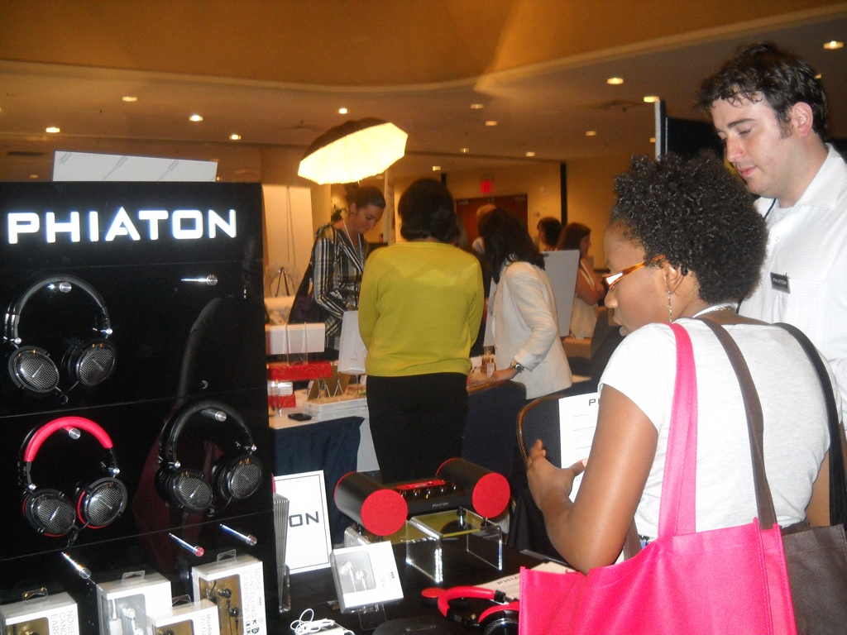
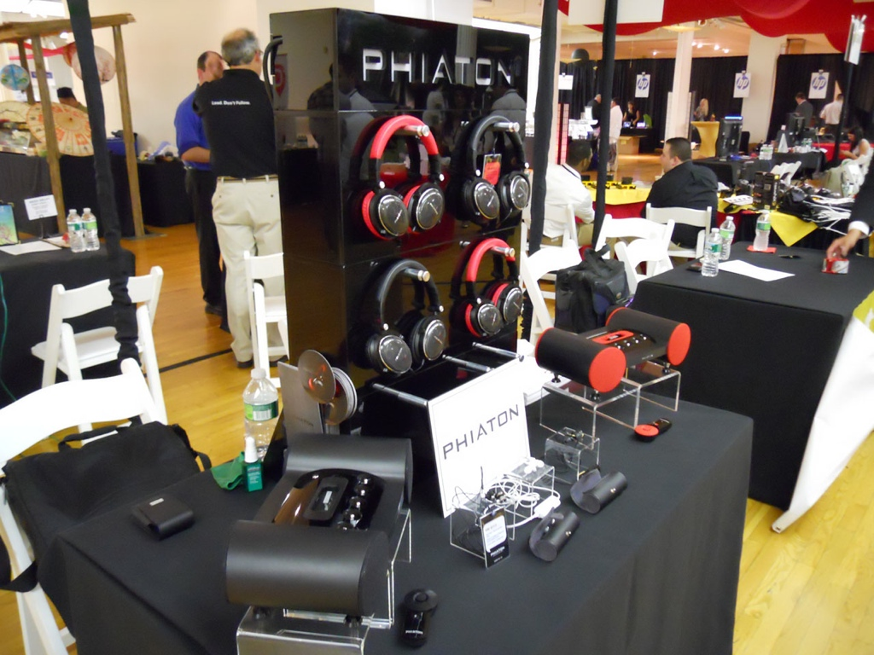
PEPCOM HOLIDAY GIFT GUIDE EVENT NYC, 2010

Slide 25
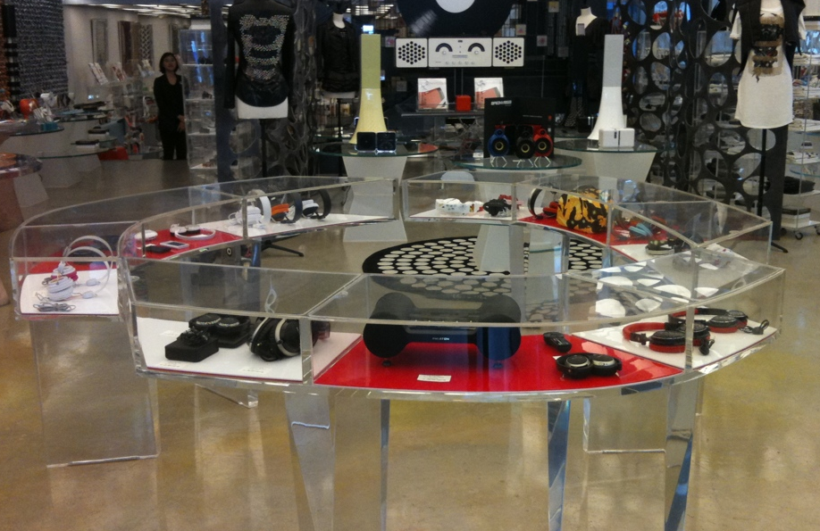
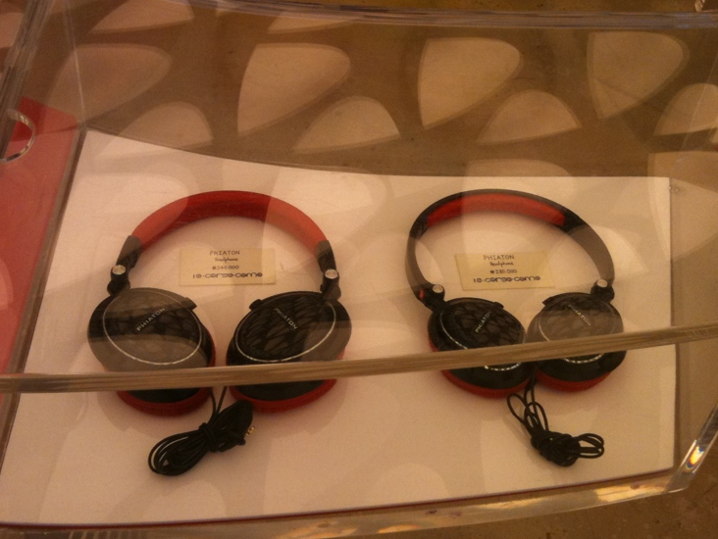
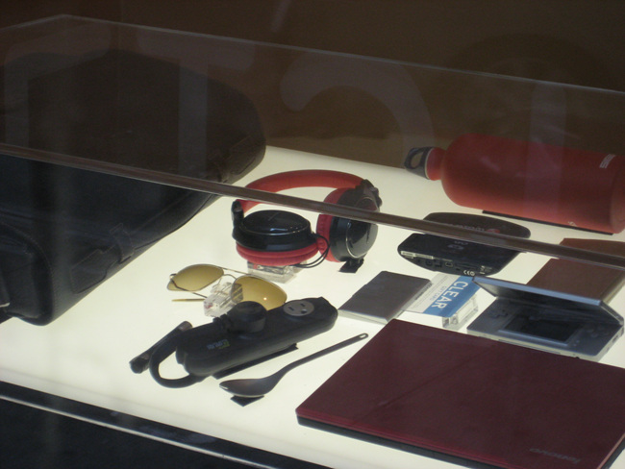
10 CORSO COMO MUSIC EVENT

Slide 26
WHAT CAN
DO FOR YOU?

Slide 27
CONTINUOUS MARKETING SUPPORT
PROVIDE GO-TO-MARKET STRATEGY
CREATE BRAND VALUE IN CHINA
DELIVER PHIATON CULTURE
GENERATE MUTUAL BENEFIT

Slide 28
SUNCHIE BRINGS PHIATON TO TIER 1 CHINESE MARKET

Slide 29
THANK YOU, AND ENJOY

